Slide 1


VITAELY-Full Stack Al SaaS App
Submitted by - Niladri Banik
Anushka Roy
Supervised by - Prof. Sarasij Majumdar
TECHNO INTERNATIONAL NEW TOWN
Department of Master of Computer Applications

Slide 2


Meet our team
Niladri Banik
Anushka Roy
18771024011
18771024005

Slide 3
Table of contents
1
Introduction
2
Overview
3
Objectives
4
Features and Scope
INDEX
5
Technology
6
Page - 7
Features

Slide 4
Introduction
VITAELY is an AI-powered career development platform that streamlines resume creation, interview preparation, skill analysis, portfolio generation, and professional productivity through intelligent automation.

Slide 5

Overview of VITAELY
AI-powered web-based SaaS platform.
All-in-one AI career development solution.
Includes resume, ATS, interview, and career tools.
Built using the PERN Stack (PostgreSQL, Express.js, React.js, Node.js).
Designed for students, job seekers, and professionals.
Focuses on automation, productivity, and scalability.

Slide 6
Project Objectives
Included features
Resume Builder
Cover Letter Generator
ATS Score Checker
Interview Preparation
AI Email Writer
Skill Gap
Analyzer
Portfolio Website Generator

Slide 7
Project Objectives
Included features
AI Project Idea Generator
Research & Publication Hub
Industry
Insights
Word to PDF Converter
PDF to Word Converter

Slide 8
Features : All in one
Cover Letter
ATS Checker
Resume Platform
Skill Gap Analyzer
Portfolio Generator
AI Email Writer
Interview Prep
Develop an AI-powered career development platform.
Create professional resumes quickly using AI.
Prepare users for job interviews.
Analyse resumes with ATS scoring.
Research Hub
Identify missing career skills
Build AI-powered portfolio websites.
Write professional emails using AI.
Support research and publications.

Slide 9
Scope Of The Project
PDF
Tools
Secure Experience
Scalable SaaS
Convert and compress PDF files.
Ensure secure user authentication.
Build a scalable PERN-based SaaS platform.

Slide 10
Technology Stack
Frontend
Backend
Database
AI Integration
React
Tailwind CSS
Axios
Node.js
Express.js
PostgreSQl
Gemini API AI
Content Generation
Prompt Engineering

Slide 11
Timing
March
April
May
June
Planning
Backend
Frontend
Document
Planning & Requirement Analysis
Server Logic Implementation
User Interface Development
Project Report Preparation

Slide 12
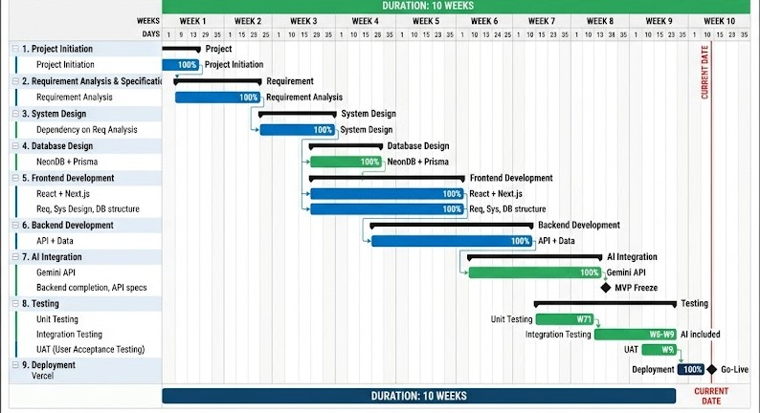
Project Planning
Total Duration: ~10 Weeks
Followed Software Development Life Cycle (SDLC)
Requirement Analysis
UI/UX Design
Frontend Development
Backend Development
AI Integration
Testing & Deployment
Documentation

Slide 13
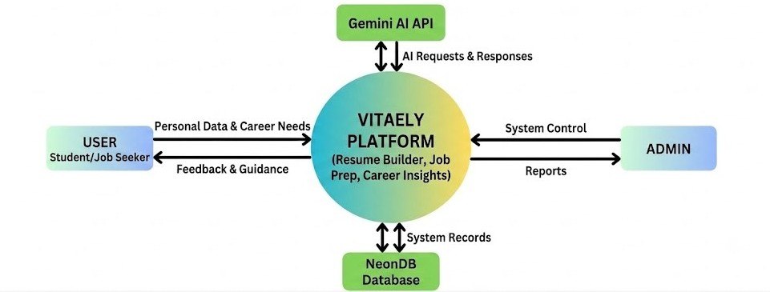
DATA FLOW DIAGRAM (DFD)

Slide 14

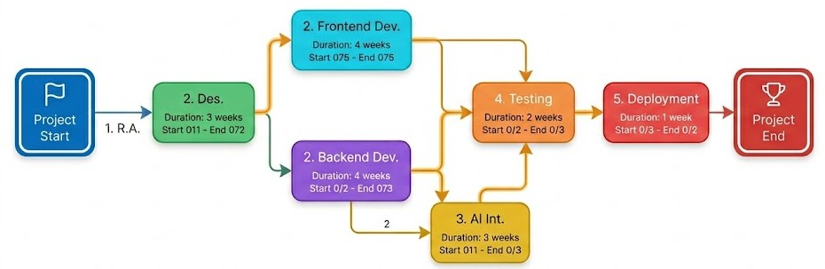
PERT Chart & Scheduling
Visualizes project task dependencies.
Identifies the critical development path.
Organizes sequential and parallel activities.
Tracks major project milestones.
Supports efficient resource allocation.
Ensures timely project completion.

Slide 15
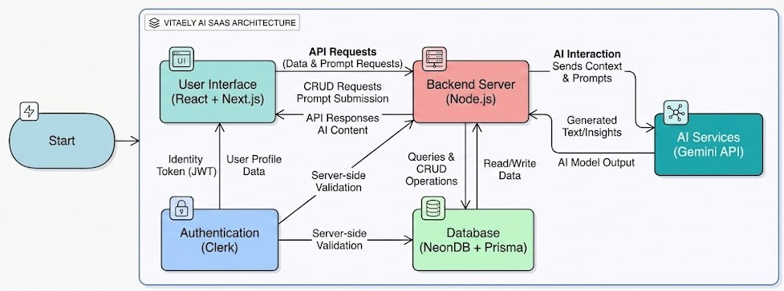
Block Diagram
Shows data flow between users, AI, backend, database, and frontend modules.

Slide 16
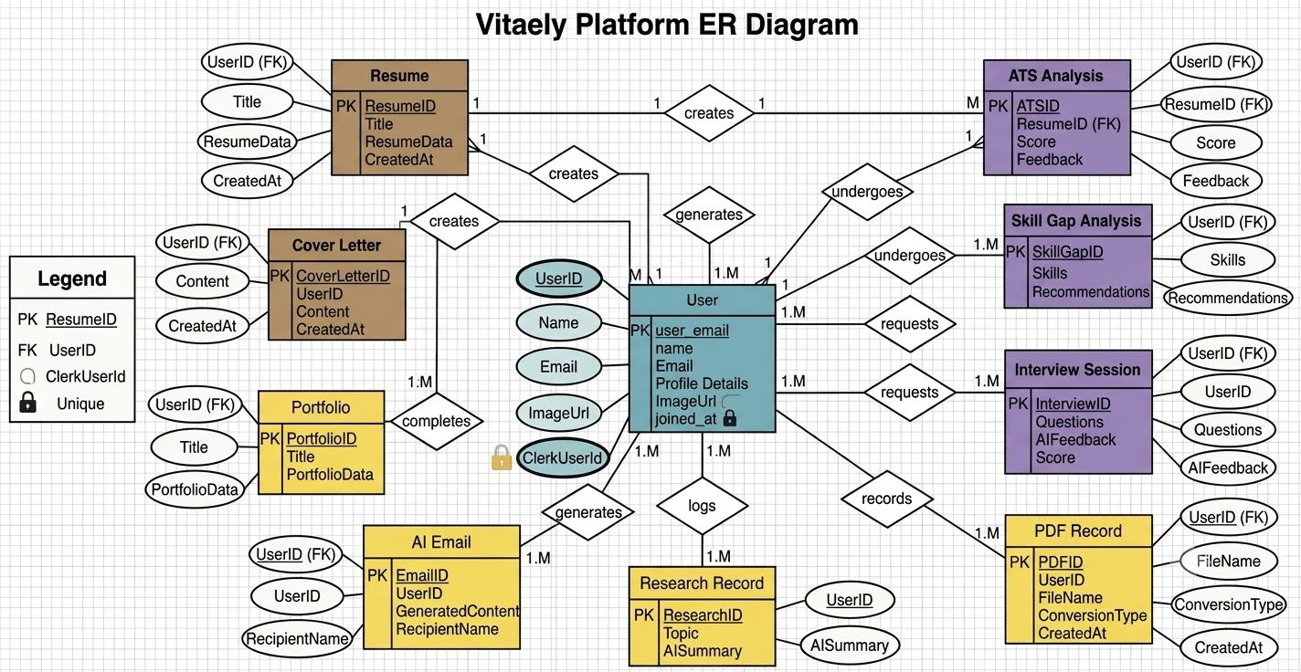
ER Diagram
Vitaely Database Architecture

Slide 17
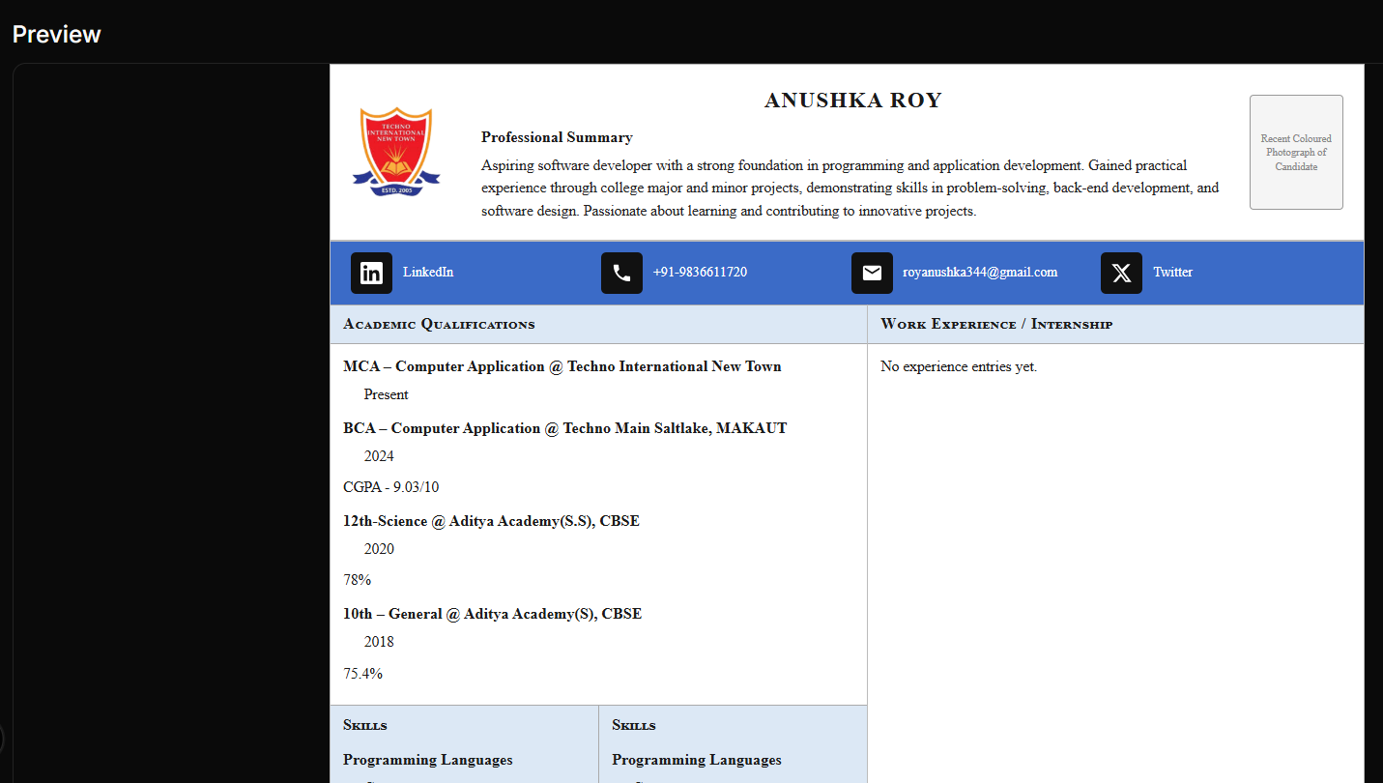
Resume Builder
50+ Resume Templates
Project Summarization
Professional Summary
Auto Resume Fill
Skills Optimization
AI Resume Builder
Auto Section Categorization
AI Content Enhancement
Real-Time Preview
ATS-Friendly Format
Experience Enhancement
PDF Resume Download

Slide 18
Portfolio Website Generator
Auto Import
Content Enhancement
Skill Categorization
Automatically imports resume information
Improves portfolio content using AI
Groups skills into categories automatically

Slide 19
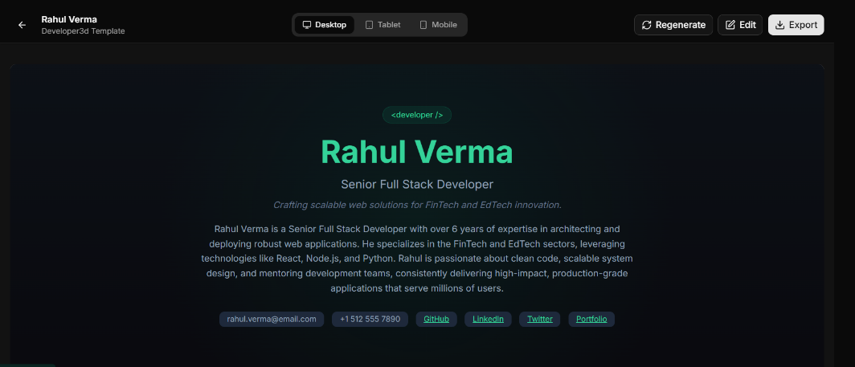
Portfolio Website Generator
Multiple Portfolio Templates
Portfolio Generation
Portfolio code
Generate professional portfolio instantly
Choose from modern portfolio designs
Download the sources code of portfolio

Slide 20
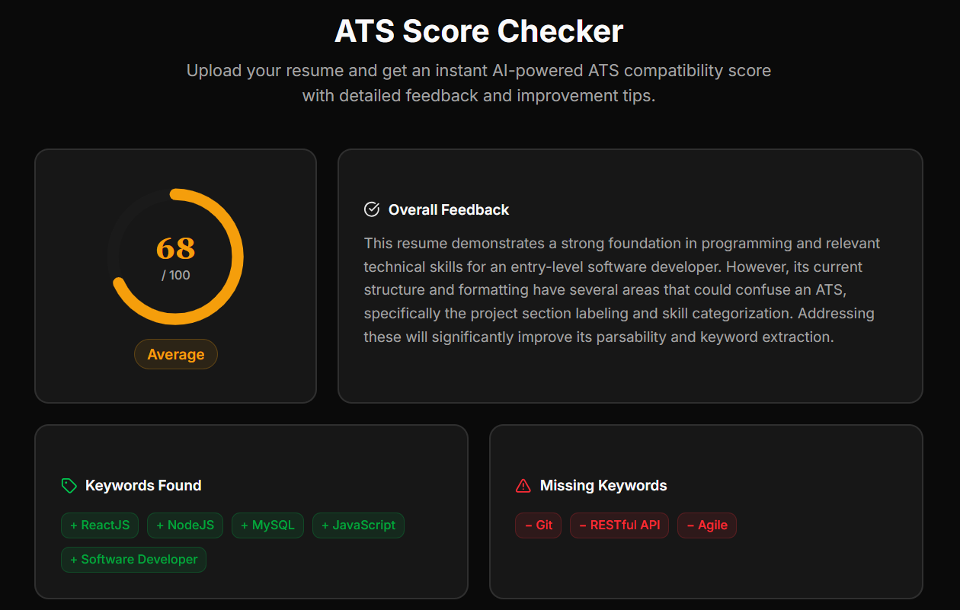
ATS Score Checker
Resume Upload
Score Analysis
Improvement
Recent History
Upload PDF or DOCX resume
Analyse resume ATS compatibility instantly
Suggests resume content improvements automatically
Displays last five ATS reports

Slide 21
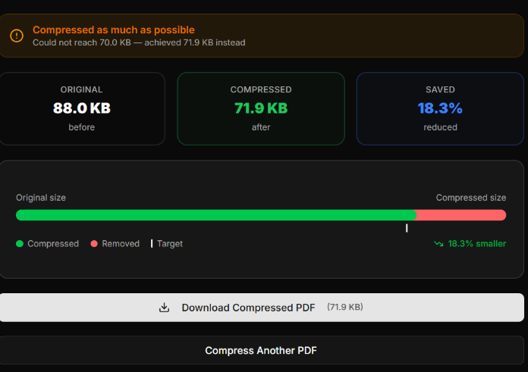
PDF Compressor
Upload PDF File
Compression Analysis
Compression Details
One-Click PDF
Download

Slide 22


Convertion Features
PDF to Word
Word to PDF
Convert PDF documents into fully editable Word files instantly.
Convert Word documents into high-quality PDF files instantly.

Slide 23
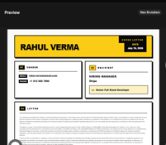
Cover Letter Builder
Grammar Improvement | Job-Specific Content
Corrects grammar and writing mistakes | Generates role-specific personalized content
PDF Download Support | Auto Information Fill
Download cover letters as PDF | Automatically fills user information

Slide 24

Skill Gap Analyzer
Skill Gap Analysis
01
Skill Match Score
02
Personalized Roadmap
03
Identifies missing career skills
Calculates overall skill compatibility
Creates customized learning path

Slide 25

Skill Gap Analyzer
Priority Skills
04
Learning Resources
05
Project Recommend
06
Highlights most important skills
Suggests courses and tutorials
Recommends practical portfolio projects

Slide 26
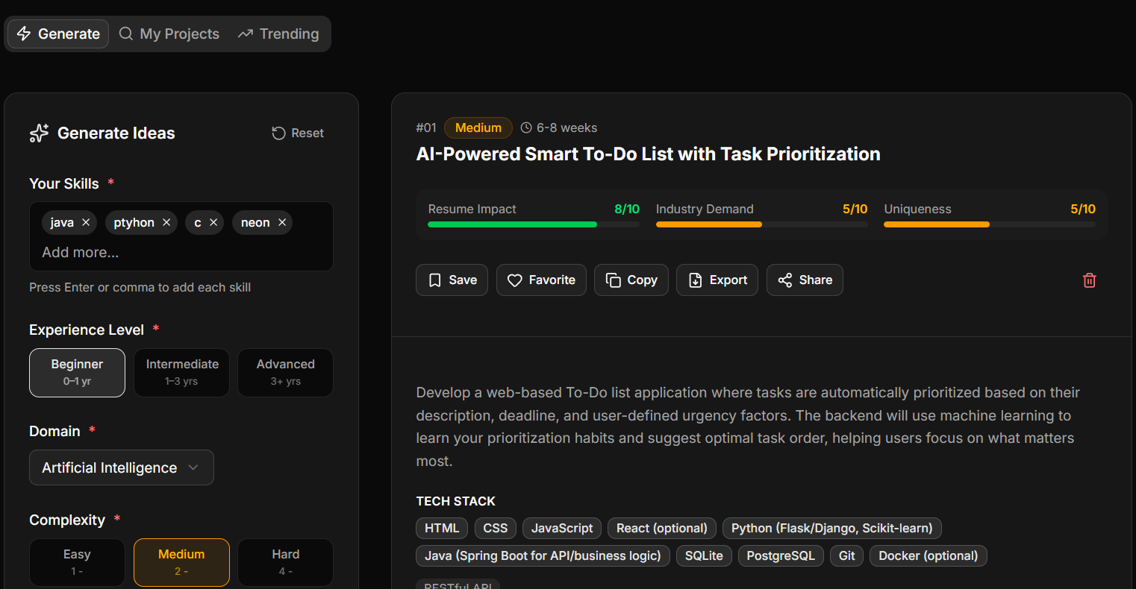
AI Project Idea Generator
Ideas
Suggestions
Roadmap
Score
Interview
Structure
Provides step-by-step implementation guide
Creates professional repository structure

Slide 27
Industry Insights
Market Outlook
Industry Growth
Compare salaries across job roles
Displays current market growth rate
40%
Top Skills
Industry Trends
Highlights in-demand technical skills
60%

Slide 28
Interview Preparation
Mock Interviews
Quiz Tests
Assessments
Based Questions
Score Analysis
Performance
Practice interviews with AI assistance
Solve technical interview questions instantly
Test logical and analytical skills
Questions tailored to specific roles
Receive immediate performance evaluation
Get personalized improvement recommendations

Slide 29
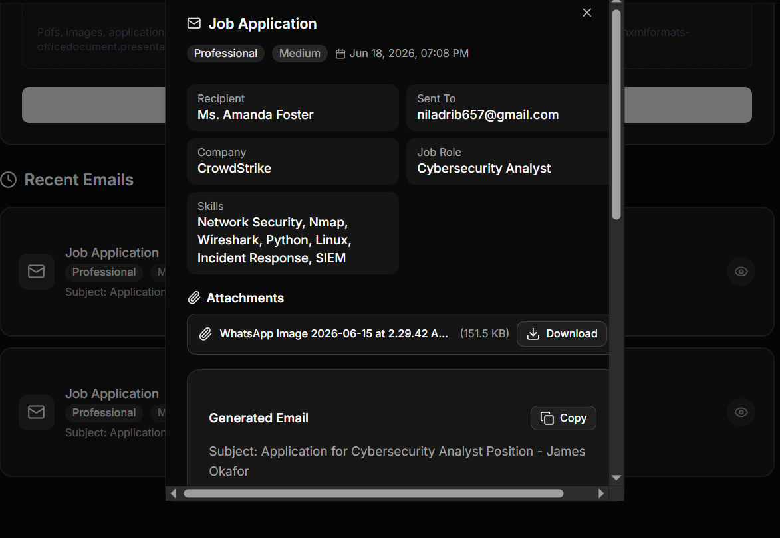
AI Email Writer
Email Generation
Recipient Information
Creates professional emails instantly
Add recipient and company details

Slide 30

Attachment Support
Email
History
Attach resumes and documents easily
View previously generated emails

Slide 31
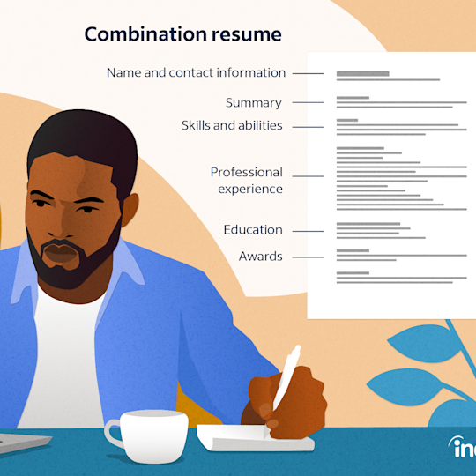
Solution
VITAELY provides an all-in-one AI-powered career development platform offering resume building, ATS analysis, interview preparation, skill gap analysis, portfolio generation, and productivity tools through a secure SaaS solution.

Slide 32


Future Scope
Mobile application
Job Portals
Develop a mobile application for Android and iOS platforms.
Integrate job portals with AI-powered career recommendations.

Slide 33

Conclusion
VITAELY successfully integrates AI-powered career development tools into a single SaaS platform, enabling resume building, interview preparation, skill enhancement, and professional growth through an efficient, secure, and scalable solution.

Slide 34
Thanks!
Dream. Build. Achieve.

